Slide 1
Interactive Recipe Finder
CAPSTONE PROJECT
Presented By:
Name: BHARATH T
College Name: Reva University
Department: MCA

Slide 2
OUTLINE
Problem Statement (Should not include solution)
System Development Approach (Technology Used)
Algorithm & Deployment (Step by Step Procedure)
Result
Conclusion
Future Scope(Optional)
References

Slide 3
Problem Statement
Many users struggle to decide what to cook with available ingredients.
Existing recipe platforms are often cluttered or don’t allow ingredient-based search easily.
Lack of features like calorie filtering, meal type categorization, and search history make meal planning harder.
There is a need for a lightweight, user-friendly, interactive recipe finder that reduces food waste and saves time.

Slide 4
System Approach
Technologies Used:
Frontend:
HTML5 → Structured webpage with Hero Section, Stats Section, and Recipe Finder UI.
CSS3 (Custom + Bootstrap 5) → Modern, responsive design, gradient backgrounds, animated cards, hero & stats sections.
JavaScript (ES6) → API integration, DOM manipulation, dynamic recipe rendering, localStorage.
Design Approach:
Hero section with key features (Smart Search, Quick Results, Healthy Options).
Sidebar for Recent Searches with highlight persistence.
Modular and clean file separation (index.html, style.css, script.js).
Fully responsive UI optimized for desktop and mobile.

Slide 5
Algorithm & Deployment
Step-by-Step Workflow:
User Input → Enter ingredients, select meal type, set calorie range.
API Call → JavaScript fetches data from Edamam Meal Planner v2 API using App ID & Key.
Response Handling → JSON results parsed into recipe cards (title, image, ingredients, link).
LocalStorage → Last recipes + search history stored; persists after page reload.
Sidebar Updates → New searches appear in recent list, last selection highlighted.
Edge Cases → Error handling for invalid input, empty results, API errors.
Deployment → Runs directly on browser using VS Code Live Server (or Netlify/GitHub Pages)

Slide 6
Result
Successfully retrieves live recipe data from Edamam API.
Displays recipes with:
Images
Titles
Ingredient preview
Link to full instructions
Sidebar shows recent searches with active highlighting.
Filters (meal type, calories) refine results.
Clear History button resets localStorage.

Slide 7
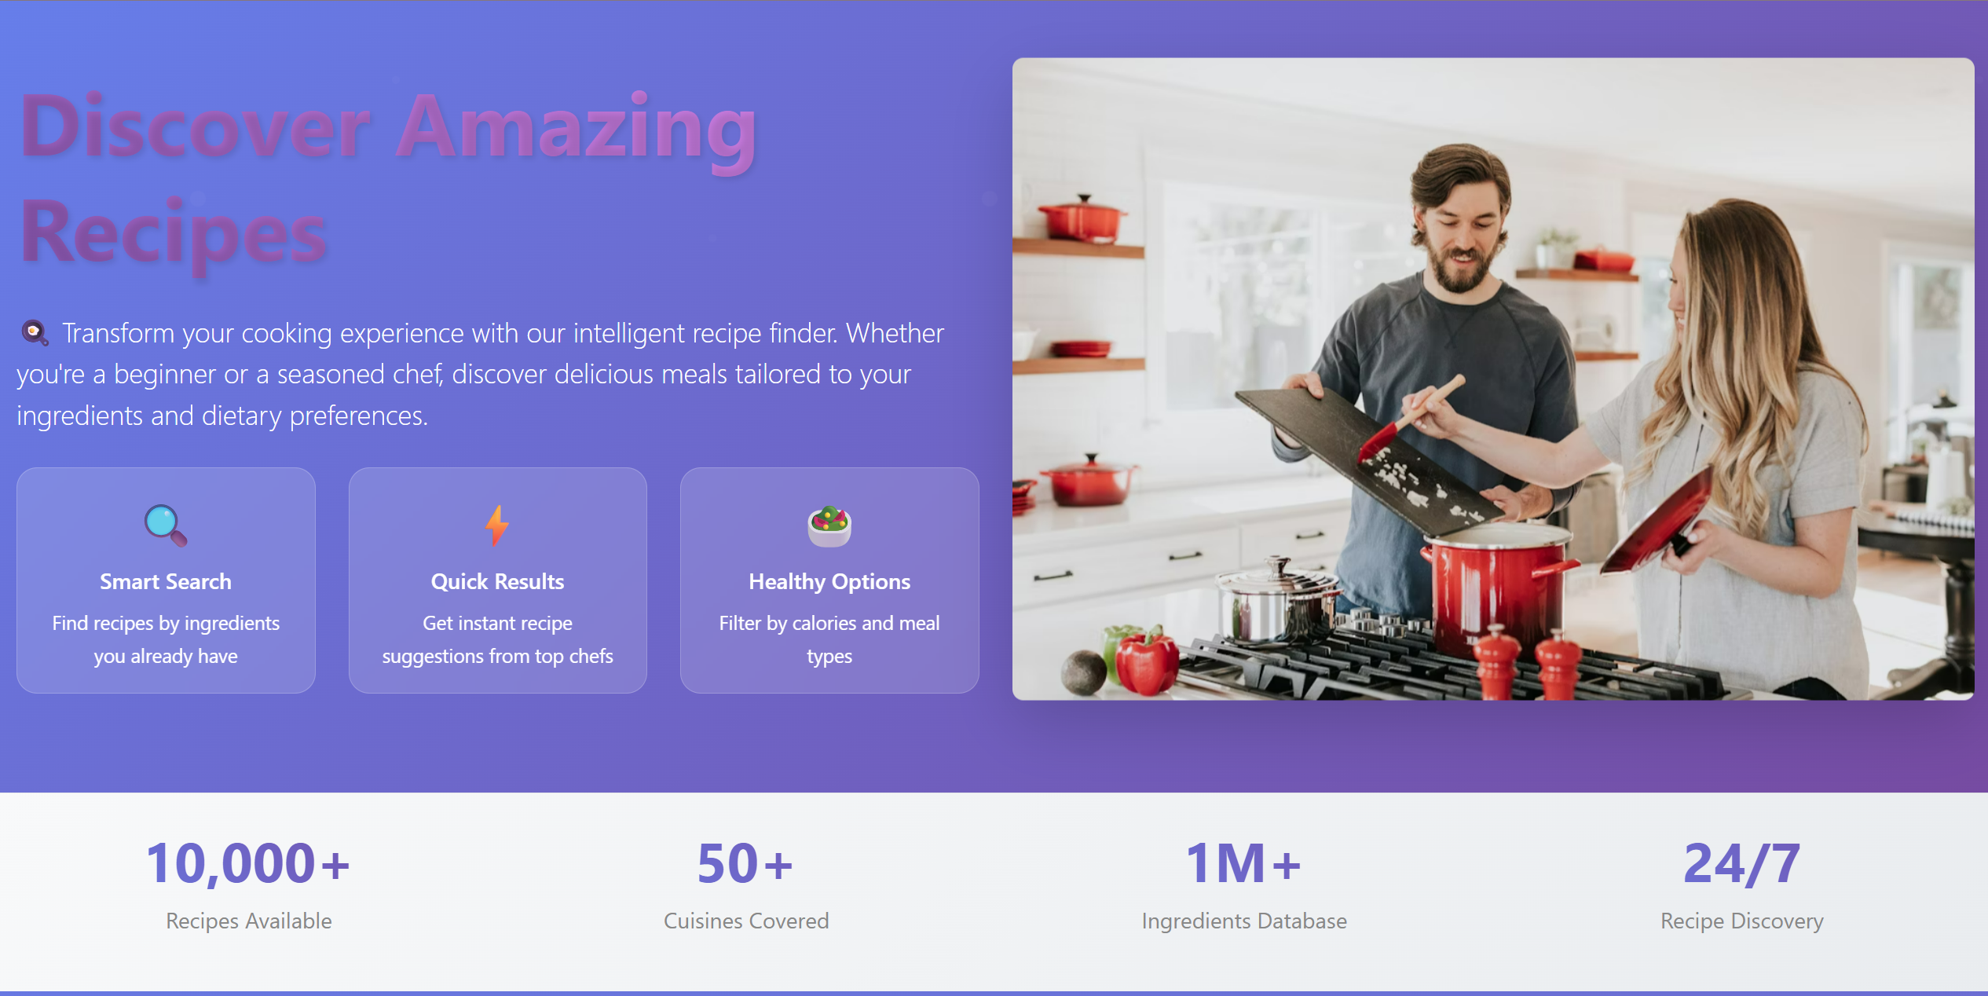
Result

Slide 8
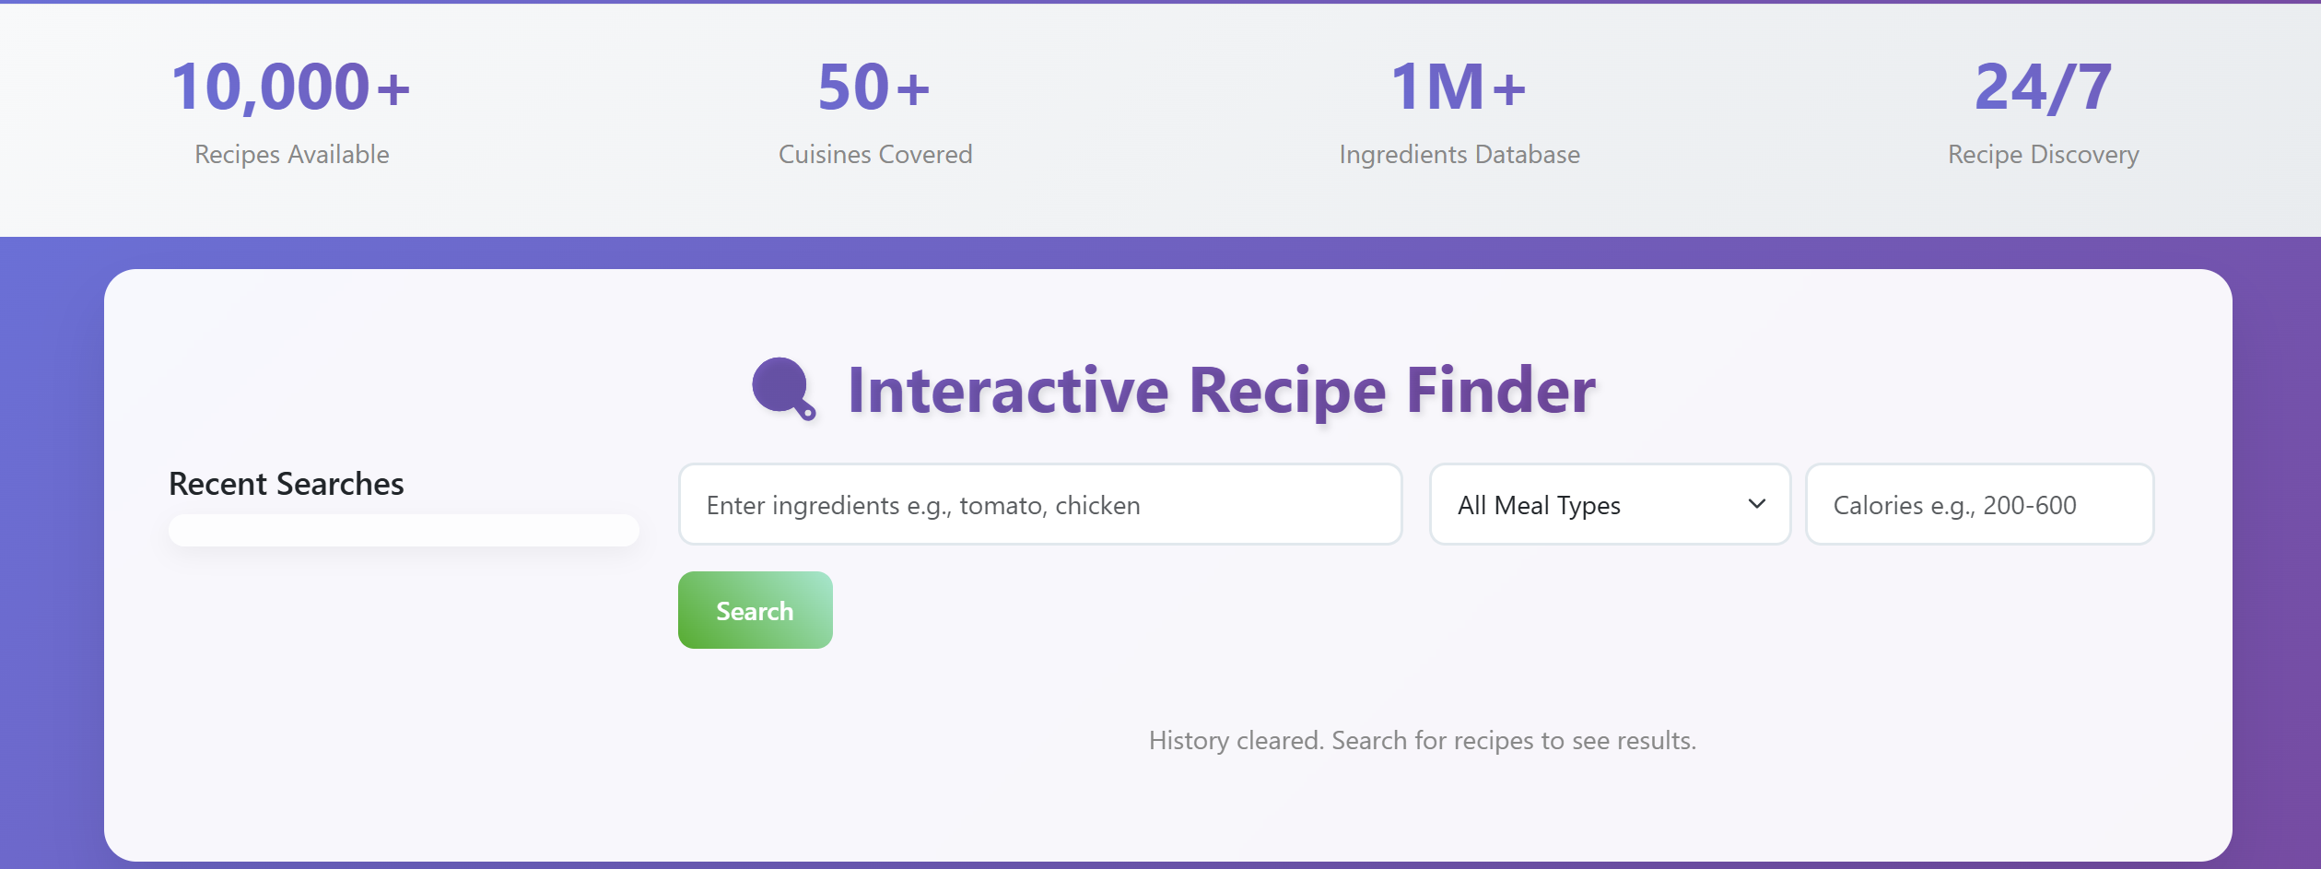
Result

Slide 9
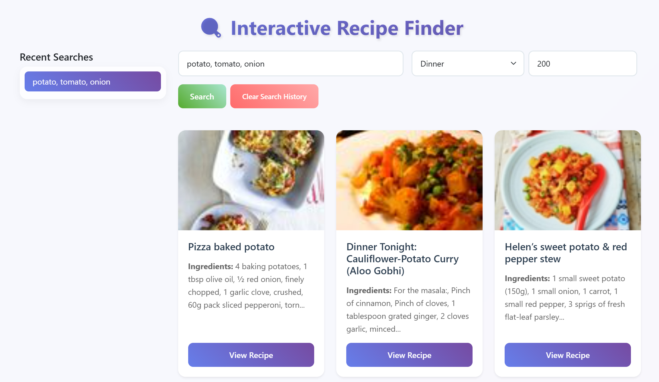
Result

Slide 10
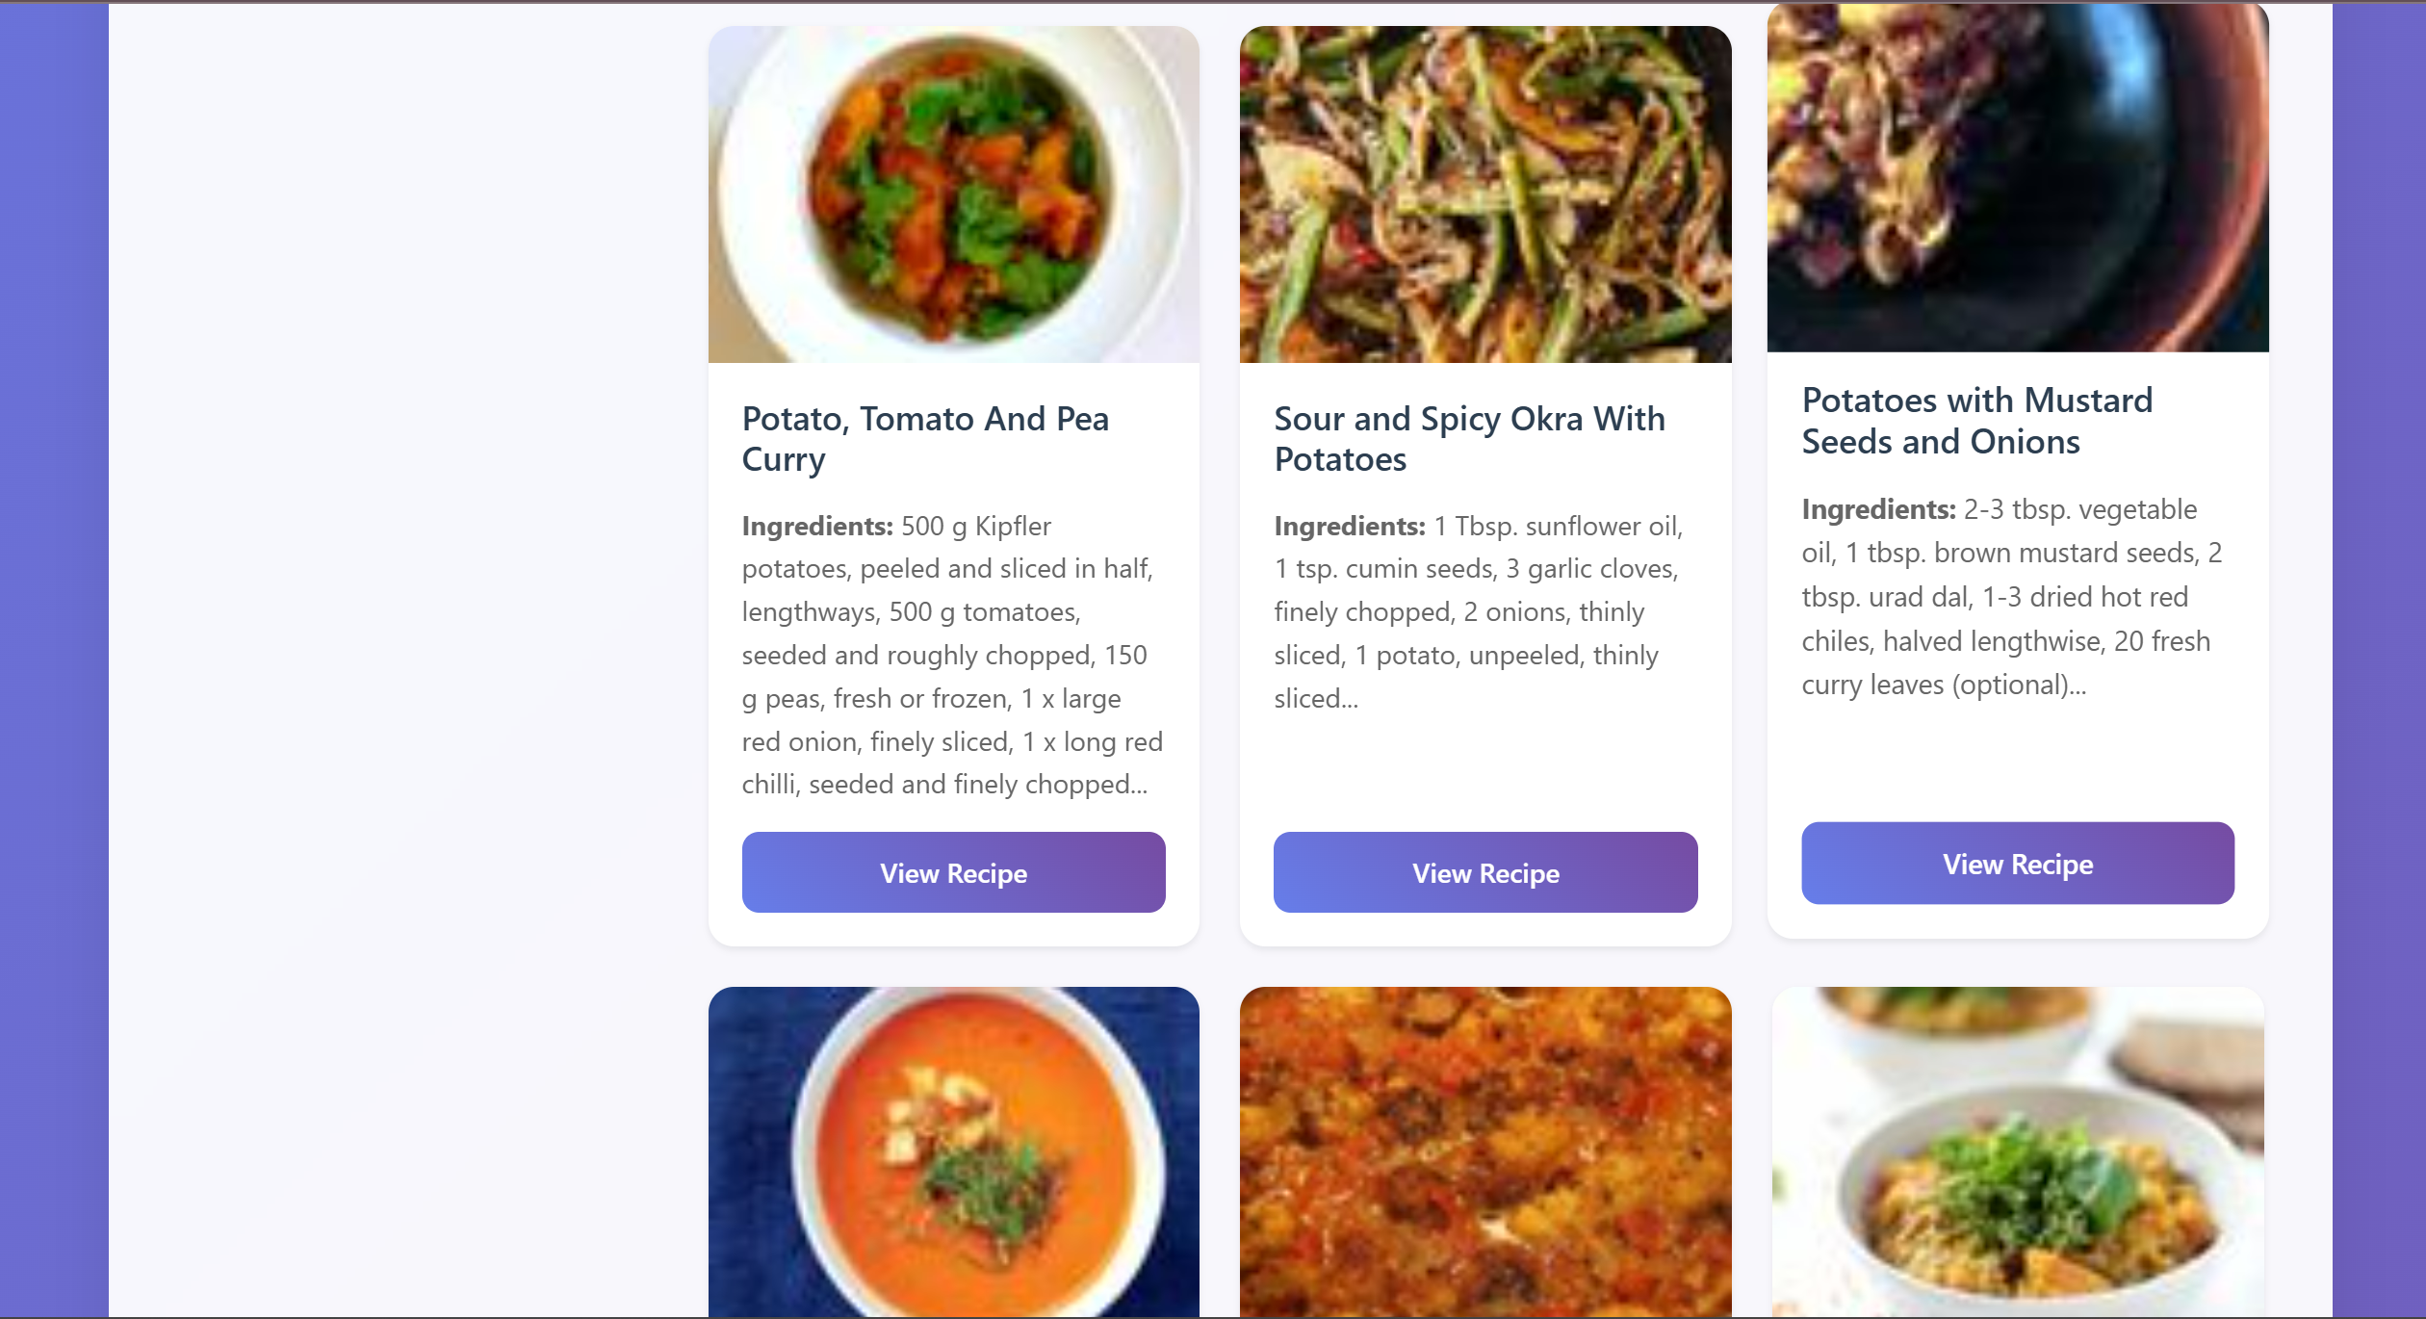
Result

Slide 11
GITHUB AND DEPLOYMNET LINK
Attach your GitHub Link : coding files
https://github.com/MR-BHARATH-T/Interactive-Recipe-Finder.git
Project Demonstration Link:
https://drive.google.com/drive/folders/1MO7BpokSqUsAazUIrIjL45zhHhEzgKVJ?usp=sharing
Deployment link:

Slide 12
Conclusion
Provides a smart, interactive meal planning tool.
Reduces food waste by suggesting recipes from available ingredients.
Easy-to-use UI with modern styling and responsiveness.
Adds value through calorie filtering, meal type selection, and persistent history.

Slide 13
Future scope
User Accounts → Personalize meal plans per user.
Backend Integration → Save searches & preferences permanently.
AI-powered recommendations → Suggest recipes based on history or diet patterns.
Mobile App Version for Android/iOS.
Voice Assistant Integration → “What can I cook with eggs and spinach?”

Slide 14
References
Edamam API Documentation – https://developer.edamam.com
Bootstrap 5.3 – https://getbootstrap.com
MDN Web Docs (HTML, CSS, JS)
Unsplash (hero section images)

Slide 15
THANK YOU

